Slide 1
Age vs Readmission and Rate

Slide 2
Total Patients by Gender

Slide 3
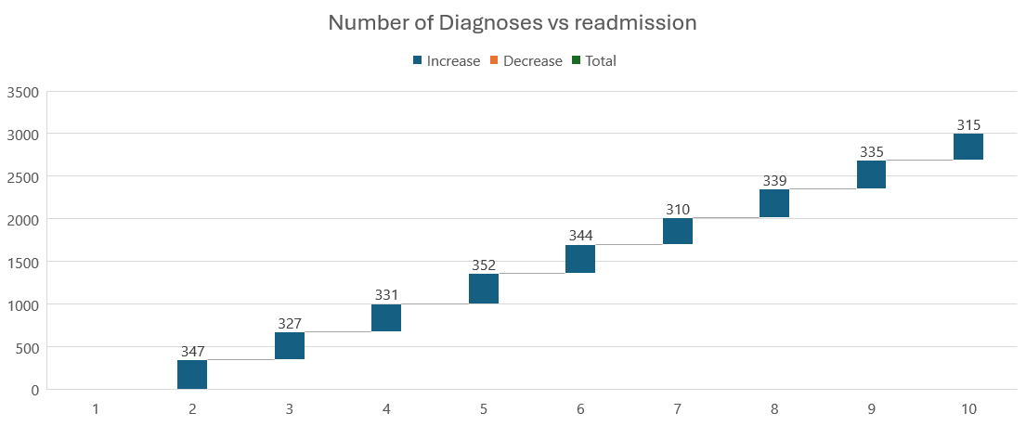
Number of Diagnoses vs readmission

Slide 4
Admission Type vs Readmission

Slide 5
Days of readmission

